Slide 1
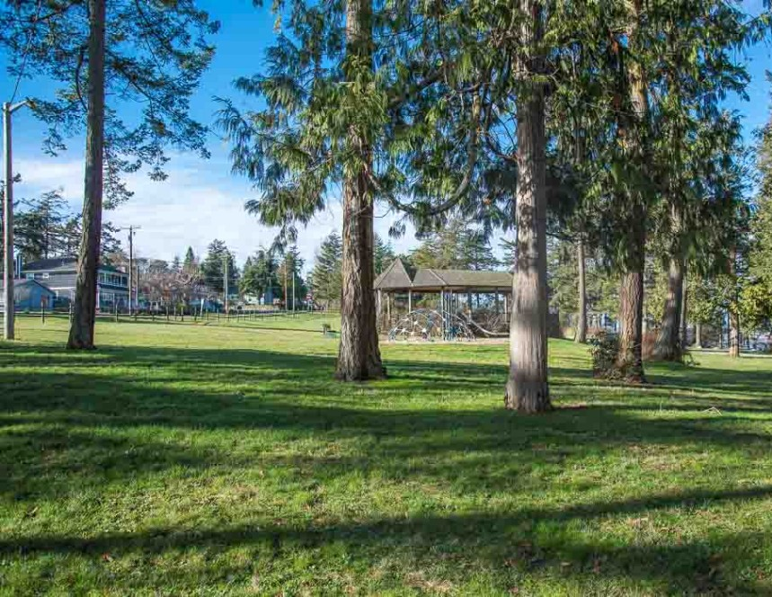
RESULTS:
Parks and Recreation Community Survey
Survey Overview:
Responses: 165
Purpose: Gather data for parks improvements

Slide 2
Parks and Recreation Survey
“Enjoy sailing in local waters”
“Kayaking, fishing, crabbing ☺”
“Other” activities include:
Discover new places
Fun, excitement and adventure
Connect with community
Affordability
“Spend time with family and friends”
“We walk the town when we have time”

Slide 3
Parks and Recreation Survey
“Love the town green – farmer’s market, dogs, kids – it’s great!”
“Other” areas include:
Lion’s Park
School facilities
Community garden
Summit Loop Park
Grace Street Parklet
“I love spending time near the water, so the wharf and boat launch are great!”

Slide 4
Parks and Recreation Survey
“Would use boat launch a lot if improved”
Residents were asked to rank these five projects from 1 to 5 in order of priority.
“Boat launch needs major repair to be used again”

Slide 5
Parks and Recreation Survey
“Lion’s Park would benefit from any improvement.”
Residents were asked to rank four projects from 1 to 4 in order of priority;
53 people answered this question.
“Add a toddler playground behind the library”
“The playgrounds are not used. No reason to spend $$”

Slide 6
Parks and Recreation Survey
“Pickleball and frisbee golf – YES!”
Residents were given five options to prioritize, and 86 people responded.
“Covered areas with picnic tables for summer gathering”
“Visitors need a place to gather.”

Slide 7
Parks and Recreation Survey
“It is difficult to navigate the gravel in any kind of wheelchair or scooter. ”
Residents were asked to “check all that apply”.
“Just improve what we have”
“Gravel path from Gould to Main on 9th Street.”

Slide 8
Parks and Recreation Survey
“Gaps in trails need to be connected”
Residents were asked to rate five areas on a scale of 1 to 5.
“The more paths, walking areas and outdoor space for the public, the better.”

Slide 9
Parks and Recreation Survey
“I think bike lanes would be fantastic!!”
Residents were asked to rate four options or choose “I do not use bike lanes”.
“I’d prefer to keep bikes as far from the road as possible.”

Slide 10
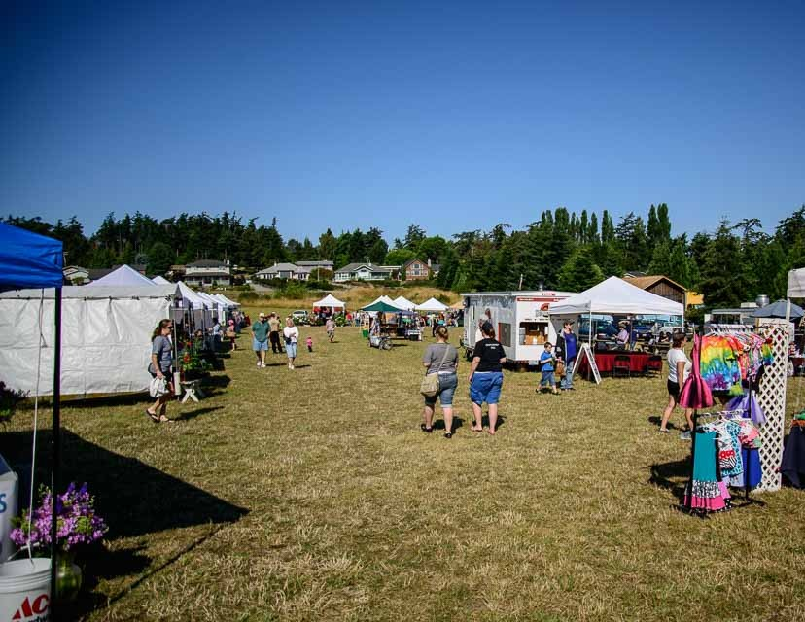
Parks and Recreation Survey
“Do you have ideas that would allow more residents to enjoy Green and Open Spaces?”
covered gathering and picnic spaces
summer concerts or programmed activities
create shaded spaces.
“Do you think the Town needs more Parks and Open Spaces? If so, where in Town are they needed?”
Some people responded that the town has plenty of parks that are underutilized.
Some people who want to see more parks cite reasons of protecting vacant or forested parcels.
Others mention that parks are needed on the east side of town and south of the highway.

Slide 11
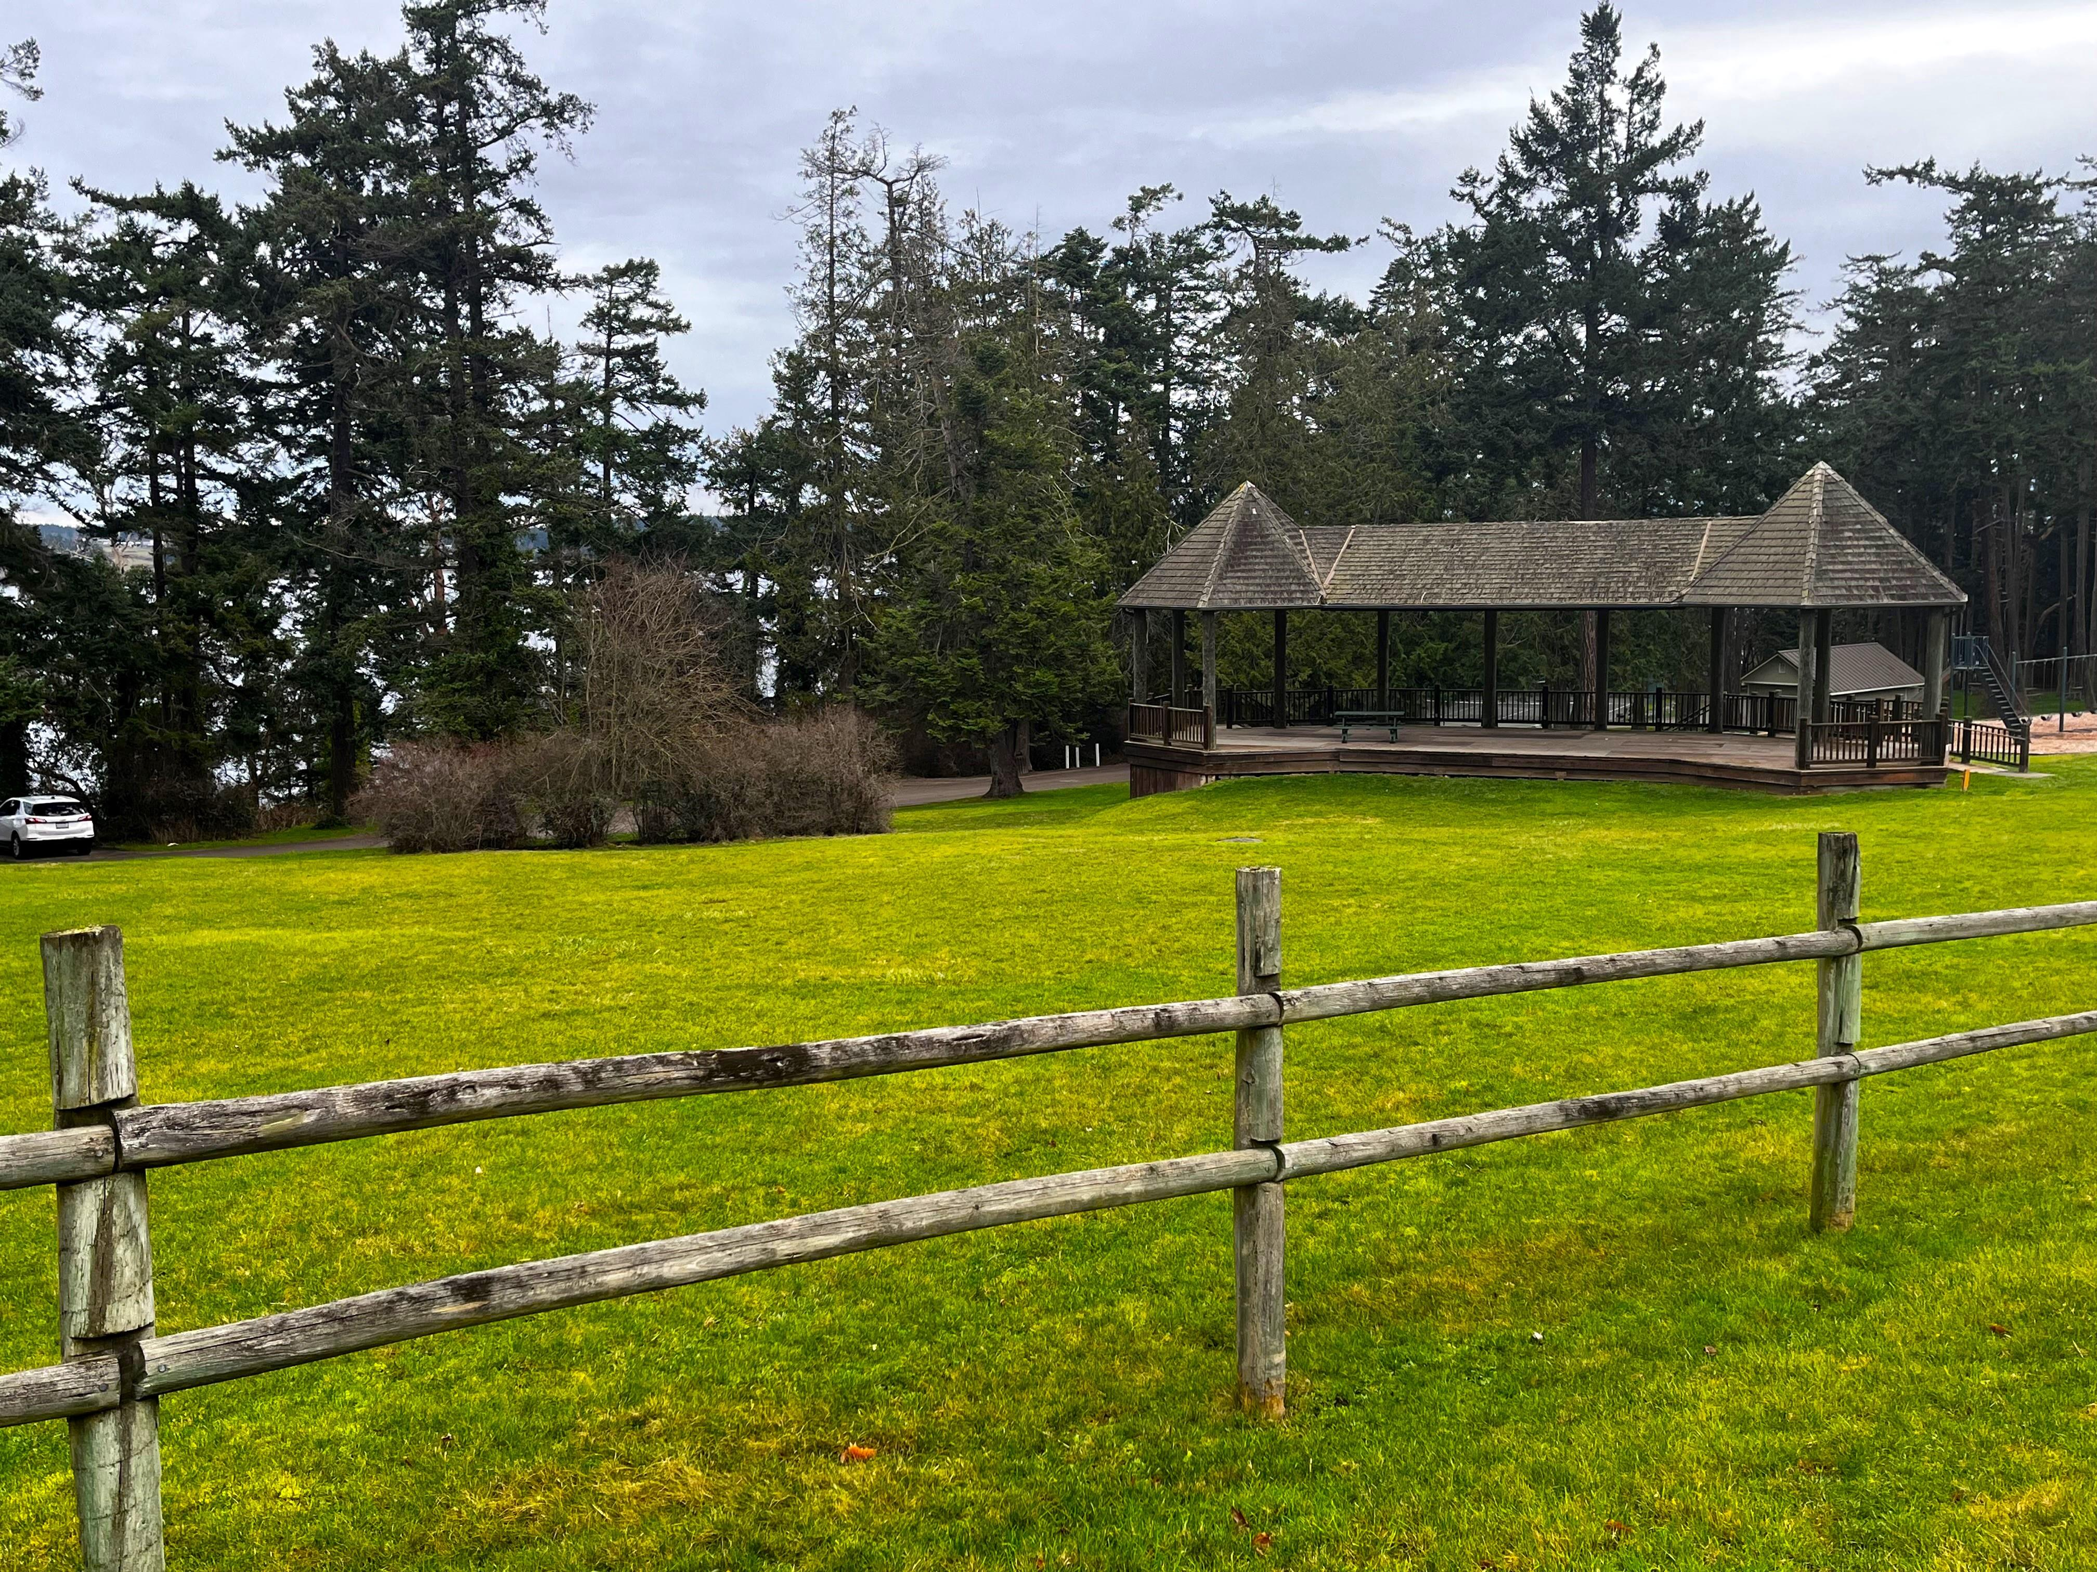

Coupeville Town Council
Park and Recreation Ad-Hoc Committee Report
January 13, 2026

Slide 12
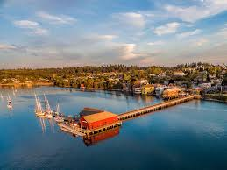
Purpose and Agenda
Acknowledge / Thank Ad-Hoc Park and Recreation Committee members
Town survey results
Parks and Recreation Committee Role and Recommendations
Community open house results

Slide 13
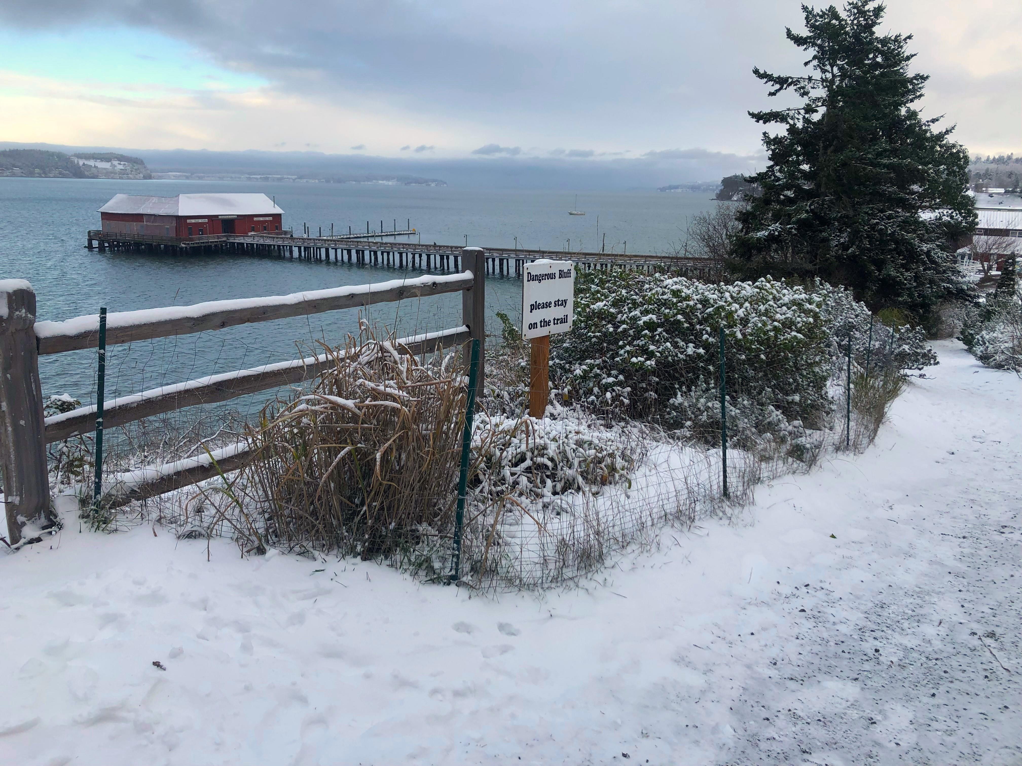
THANK YOU!
Parks and Recreation Committee Members
Robin Hertlein
Atalie Rudat
Beverly Sheridan
Travis Dotson
Juniper Sanders
Libby Britton
Dave Wechner
Kyle Renninger
Holly Miller
Jay Adams
Town Reps:
Mayor Molly Hughes
Joe Grogan, Public Works Director
Lisa Walsh, Assistant Planner
Donna Keeler, Facet

Slide 14
Committee Role
Review inventory of existing park and recreation facilities
Amenities
Uses
Brainstorm potential improvements for each
What would you like to see in this park/space?
What are your favorite things about this facility?
What are overall improvements needed?
Do you think this space is used effectively?

Slide 15
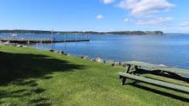
A note on…
AD-Hoc Committee Recommendations
Represent brainstorming ideas or “wish list” only
Not prioritized
Have not obtained formal approval

Slide 16
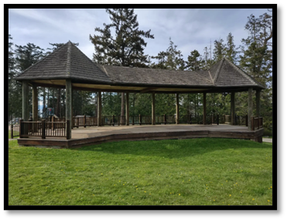
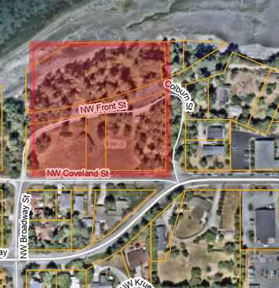
Town Park
NW Coveland Street
Seating and gathering areas with benches, picnic tables, a pavilion, and a kitchen
Recreation and play areas: tennis court, ping-pong table, playground equipment
Amenities: Water fountain, restrooms
Committee Recommended Facilities / Improvements
New playground equipment (period appropriate)
Beach trail improvements (In progress)
ADA parking by restrooms
New trees/ landscaping
Picnic tables overlooking pavilion
Interpretive signage
Other
Human and Pet Water Station (Completed)
Dog bag dispenser (Completed)
Ivy removal / tree restoration (In progress)
Pavilion repairs
Tree ring stabilization

Slide 17
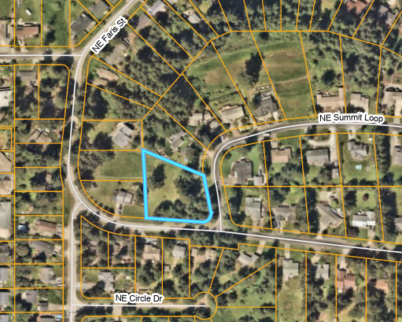
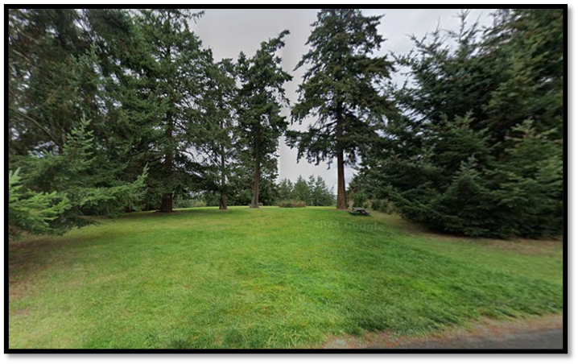
Summit Loop Park
NE Summit Loop
Undeveloped, open space for passive recreation
Picnic table and park bench
Sledding area in the winter
Recommended Facilities / Improvements
Low-maintenance landscaping
Low-impact playground equipment
Garbage can/doggie bag station
Signage to identify park
Define and designate parking spaces
Add picnic tables
Restroom facilities

Slide 18
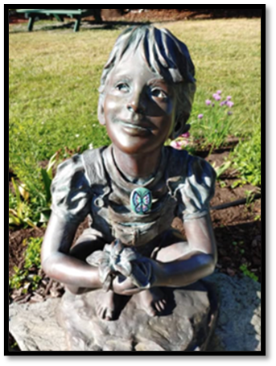
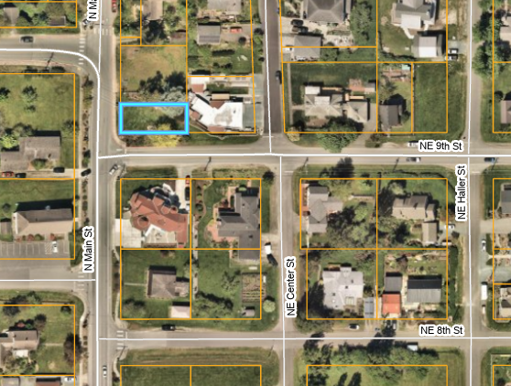
Cook’s Corner Park
N Main St & NE Ninth St
Lovely garden maintained by the Coupeville Garden Club
Sculptures and benches
Focal point for holiday celebrations
Gateway to the waterfront
Recommended Facilities / Improvements
Develop as historic community gateway
Install new signage
Install Penn Cove history marker
Use a real Christmas tree
Enhanced bike parking and trash cans
Add seating areas, picnic tables, garbage receptacles
Other
Consider linking to Johnson Lot
Keep “open space” feel

Slide 19
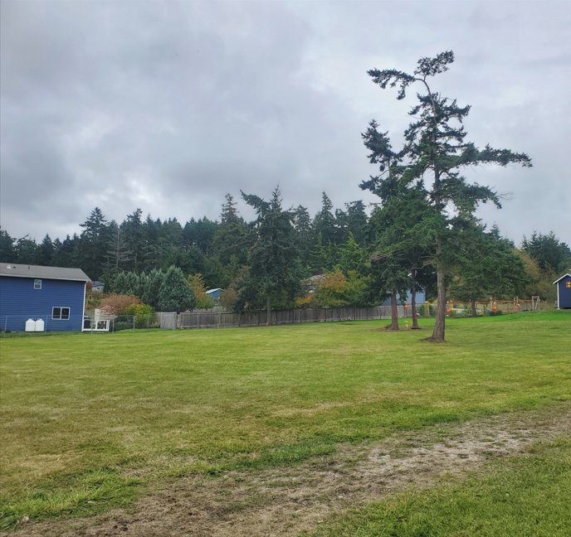
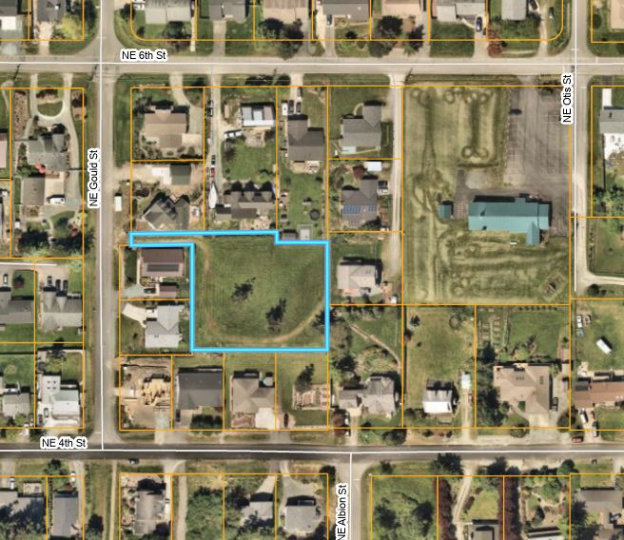
Gould Street Open Space
NE Gould Street
Open space that is a 0.69-acre area that has been left undeveloped
The Town maintains the park in the summer.
Recommended Facilities / Improvements
Improve access to the area
Install signage “Secret Park/Garden”
Small playground area near trees
Raised garden beds

Slide 20
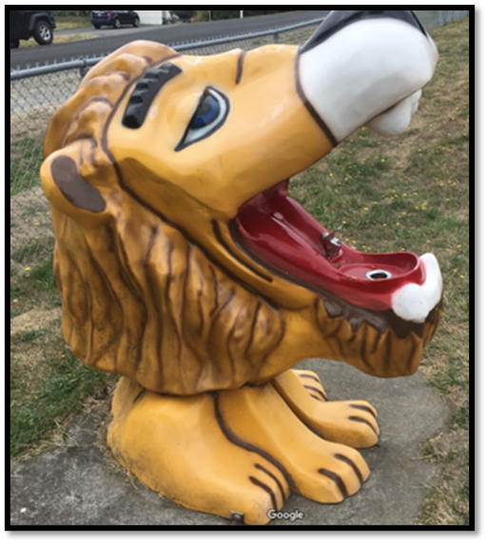
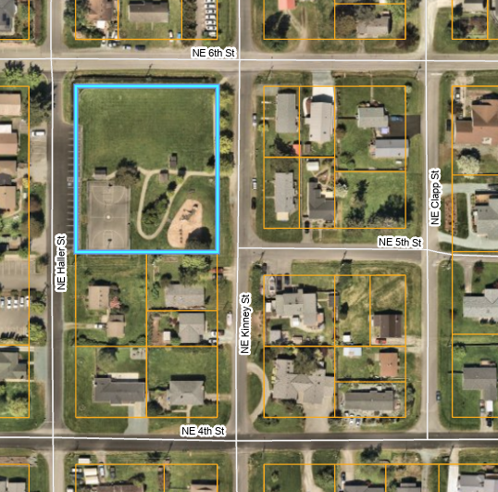
Lions Park
501 NE Haller Street
Seating & Gathering Areas: 2 benches, 3 picnic tables
Recreation: Playground equipment, basketball court, T-ball field
Public restrooms
Recommended Facilities / Improvements
Update sport/ playground equipment
Level T-ball field
New shade trees and greenery
Small community garden
Tables and benches under trees
Pickle Ball Court
Build covered picnic areas
Other
Replace / repair water fountain

Slide 21
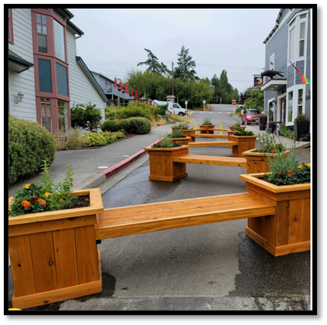
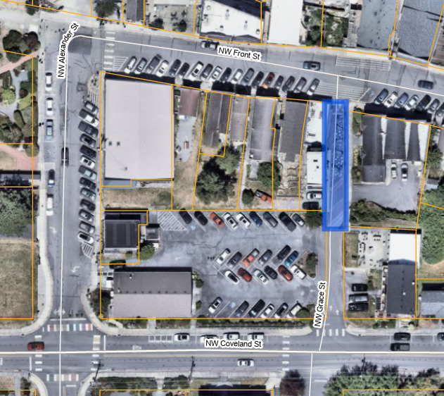
Grace Street Parklet
NW Grace Street
Seating Area adorned with planters
Bike rack at the park’s entrance
A place to pause, relax and enjoy the charming surroundings
Recommended Facilities / Improvements
Expand bike rack area
Install E-bike facility
Remove sidewalk curbs
New benches with different layout
Themed wayfinding signs (boat, water, farm, Indigenous theme)

Slide 22
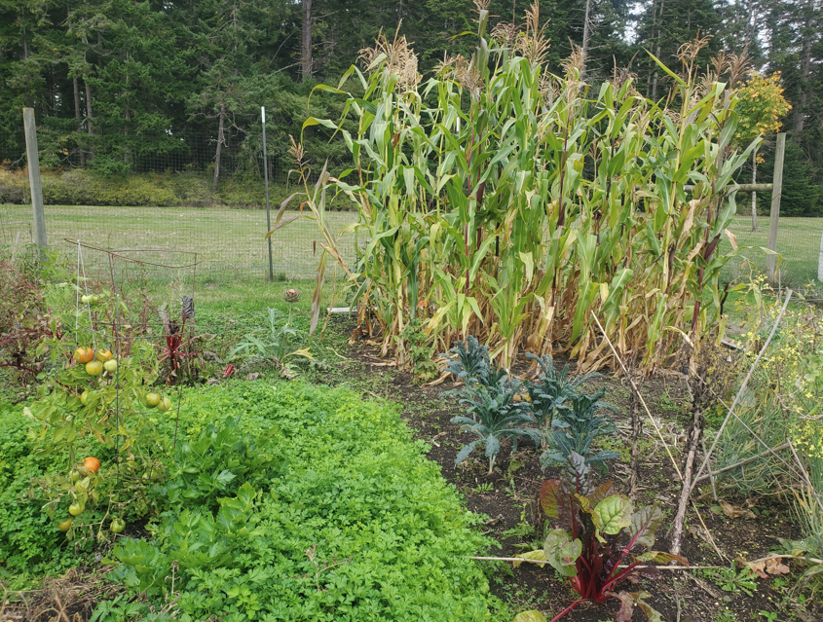
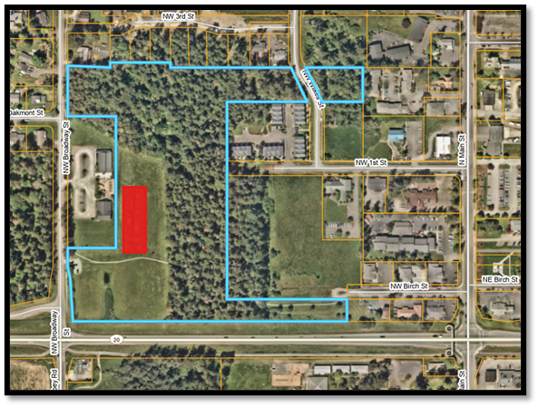
Community Garden
NW Broadway
Community Garden with 60 garden plots, fully rented in 2025
Wooded area with several trails
Recommended Facilities / Improvements
Improve access to the area
“Community Garden” sign on NW Broadway
Soccer or sports field west of the garden, screened from highway.
Potential pickle ball location
Incorporate disc golf
New trees
Improve major trails, allow minor trails to grow over

Slide 23
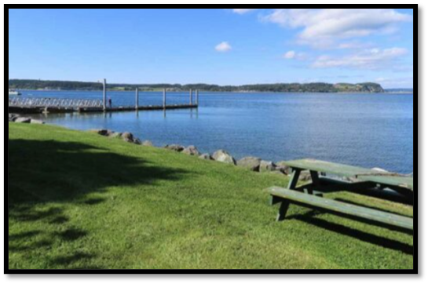
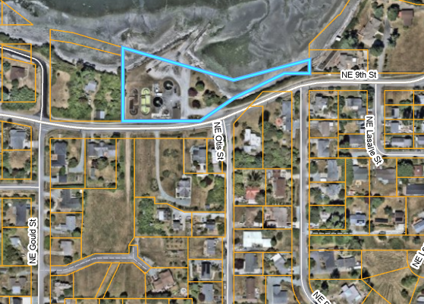
Captain Coupe Park
600 NE Ninth Street
Seating & Gathering areas: 2 benches, 2 picnic tables
Recreation: Boat launch, trailer parking, water access
Restroom facilities
Recommended Facilities / Improvements
Vegetative screening from wastewater treatment plant
Signage at boat launch regarding use (who, when, how)
Install racks behind restrooms for small boat/kayak storage
Implement 1997 plan for this park
Install Loaner lifejacket station
Construct RV dump stations
Repair/replace non-motorized boat launch
Other
Boat launch repairs / maintenance
English ivy control
Improve or remove access to “stairway” north of treatment plant
Remove remnants of concrete / debris along rock wall (bulkhead)

Slide 24
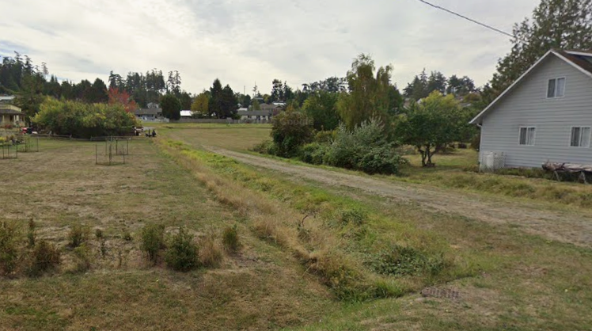
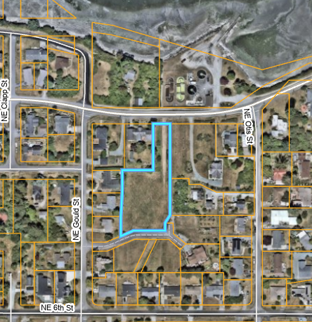
Ninth Street Green Space
Across from Captain Coupe Park
Currently used seasonally for trailer parking
Town maintains the area in the summer
Recommended Facilities / Improvements
Name site and add signage off NE Ninth Street
Low-growing shrubbery buffer between green space and adjoining homes
Stormwater treatment area from nearby neighborhood
Parking for festivals, potentially with shuttle to Front Street businesses
Walking path along east side with crosswalk on NE Ninth Street
Seed with pollinator-friendly, mowable cover crop
Barricade when grass is too wet/soft for parking

Slide 25
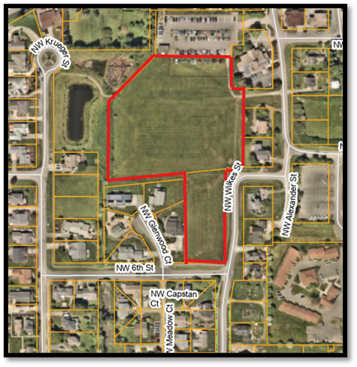
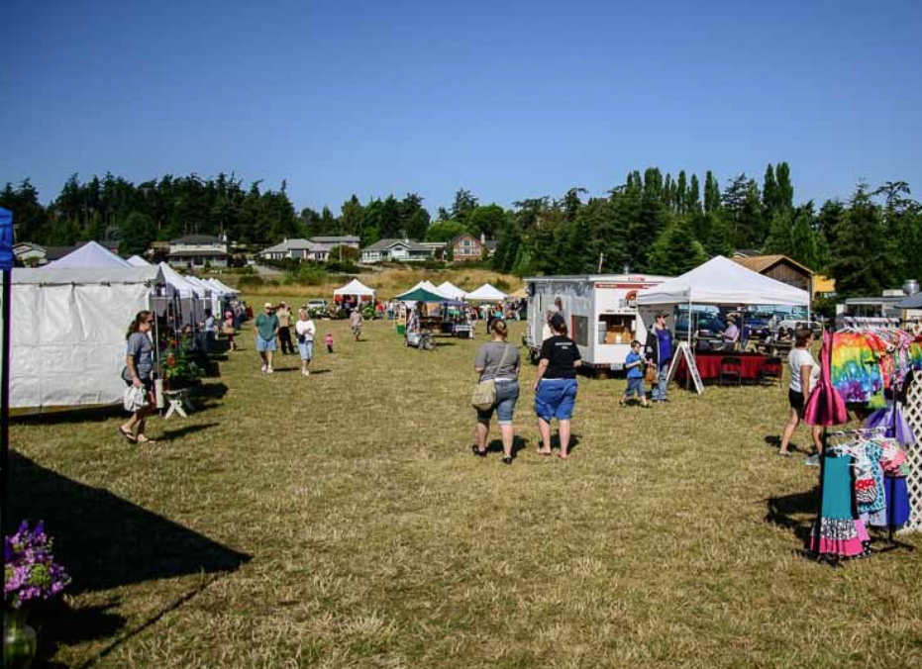
Community Green
501 NE Haller Street
Park spans nearly five acres
Central hub for community activities and events
Home for Coupeville Farmer’s Market
Public restrooms built in 2019
Recommended Facilities / Improvements
Add garbage cans by restrooms
Add e-bike charging station/ bike parking
Create transit hub
Develop 1-acre play area on south portion, being mindful of impacts to neighbors
Use 1-acre south portion for affordable housing
Create trails from restroom to Third, and from Wilkes to the Library crosswalk
Reseed with pollinator-friendly, mowable cover crop

Slide 26
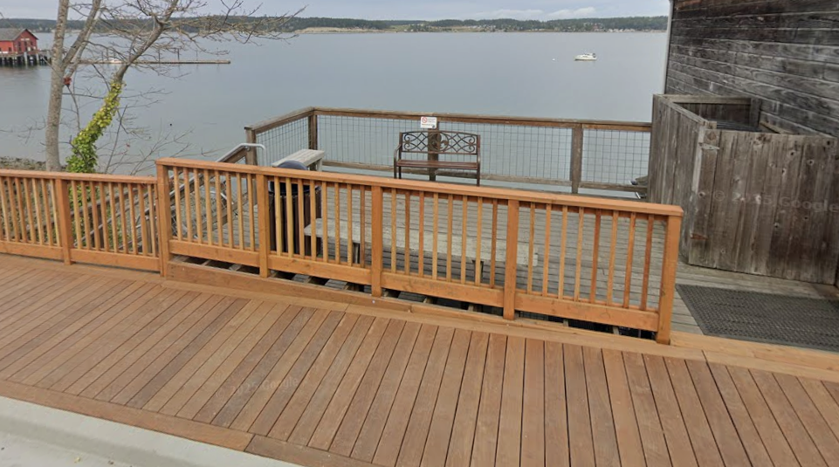
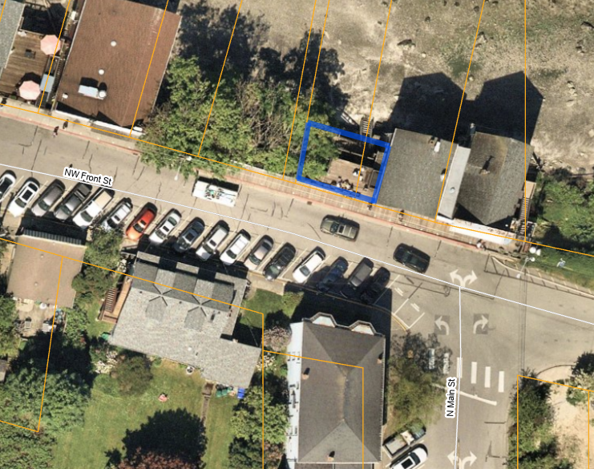
Front Street Deck and Beach Access
Elevated public deck overlooking the water with bench seating
Stairs provide direct beach access
Recommended Facilities / Improvements
Expand deck area (multi-layered)
Install signage to identify public area and public beach access
Telescope for whale watching
Adjust sidewalk railing so entrance is wider

Slide 27
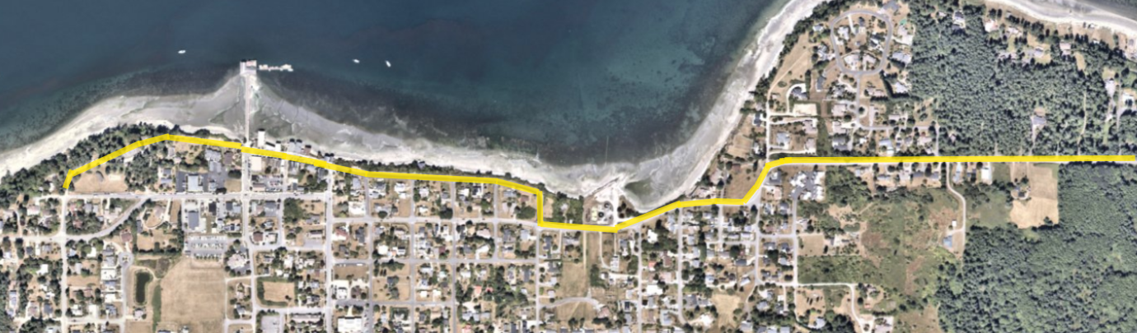
Waterfront Walk
East/West trail from Town Park to Price Sculpture Forest
Recommended Facilities / Improvements
Signage and/or map showing location of trail
Make trail accessible for bicycles
Add picnic tables and more seating along path
Maintain bluff to keep trail from eroding
Improve path between Front Street and Town Park
Reseed with pollinator-friendly, mowable cover crop
Consider adding more observation areas

Slide 28
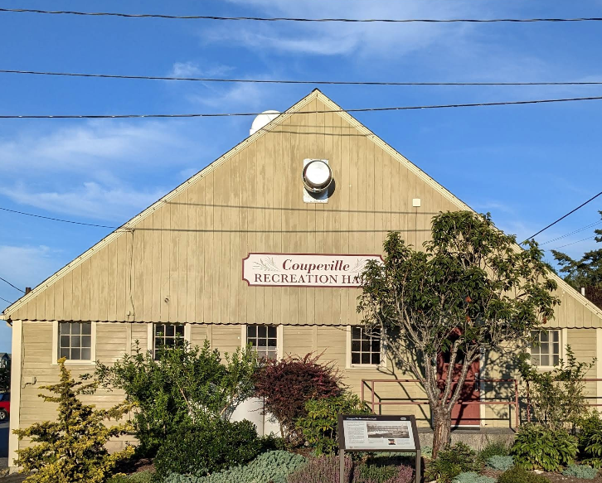
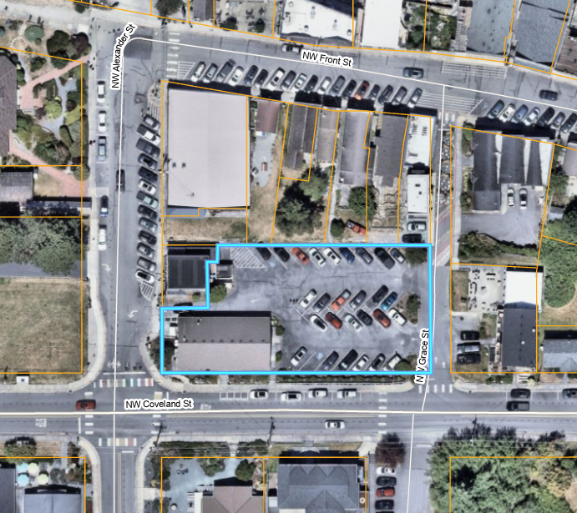
Community Rec Hall
901 NW Alexander Street
Capacity for up to 150 people
Chairs and tables provided
Kitchen facility and restrooms available
On-site parking
Recommended Facilities / Upgrades
Repair wood floor
Maintain building so it lasts another 100 years!
Add exterior public bathrooms (Done!)

Slide 29
Other Park Improvements
Committee Ideas
Playground/park south of Hwy 20
Add small community gardens to various parks throughout town
Establish an RV parking area
Create park naming criteria
Build new playfields, athletic fields and play courts
Pickle ball courts (anywhere in Town)
Develop a formal Parks, Rec & Open Spaces (PROS) Plan
Consider a gifting ordinance to fund improvements
More picnic and gathering areas
Ensure trails and pathways are connected
Rainbow Bridge for pets
Fully develop memorial bench program
Establish naming criteria (can be done as part of PROS Plan)

Slide 30
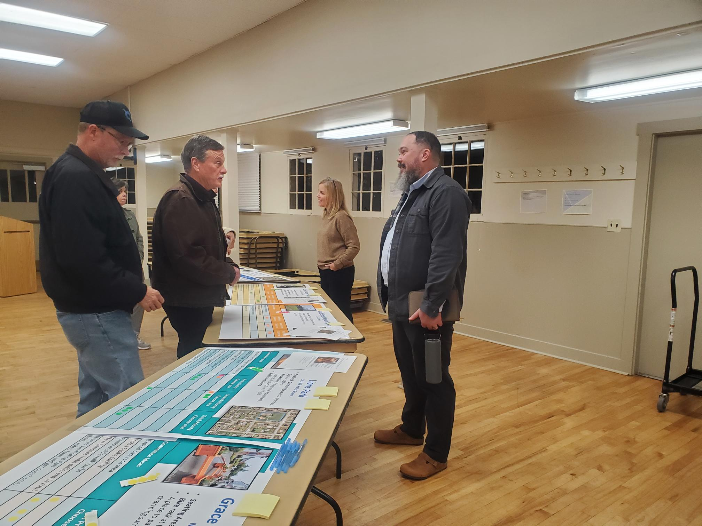
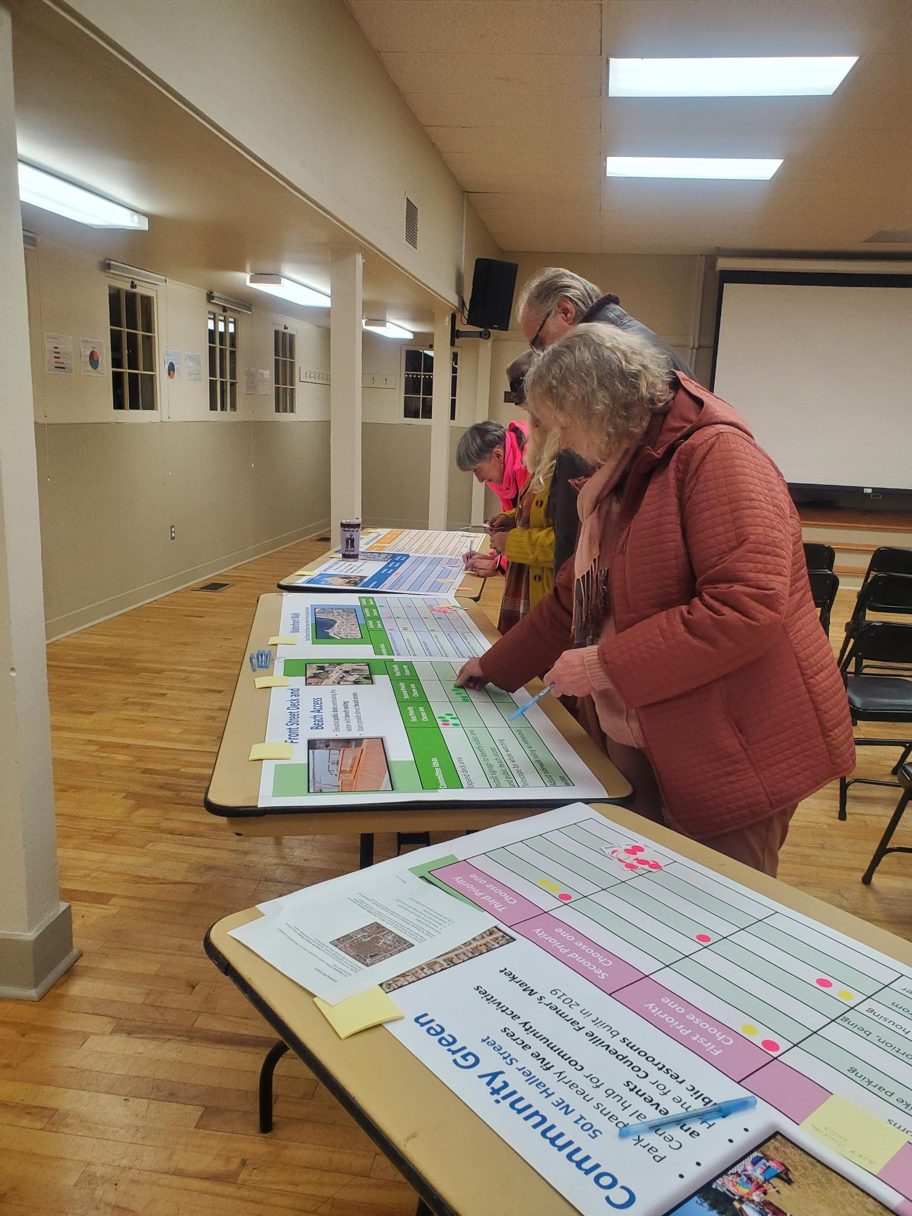
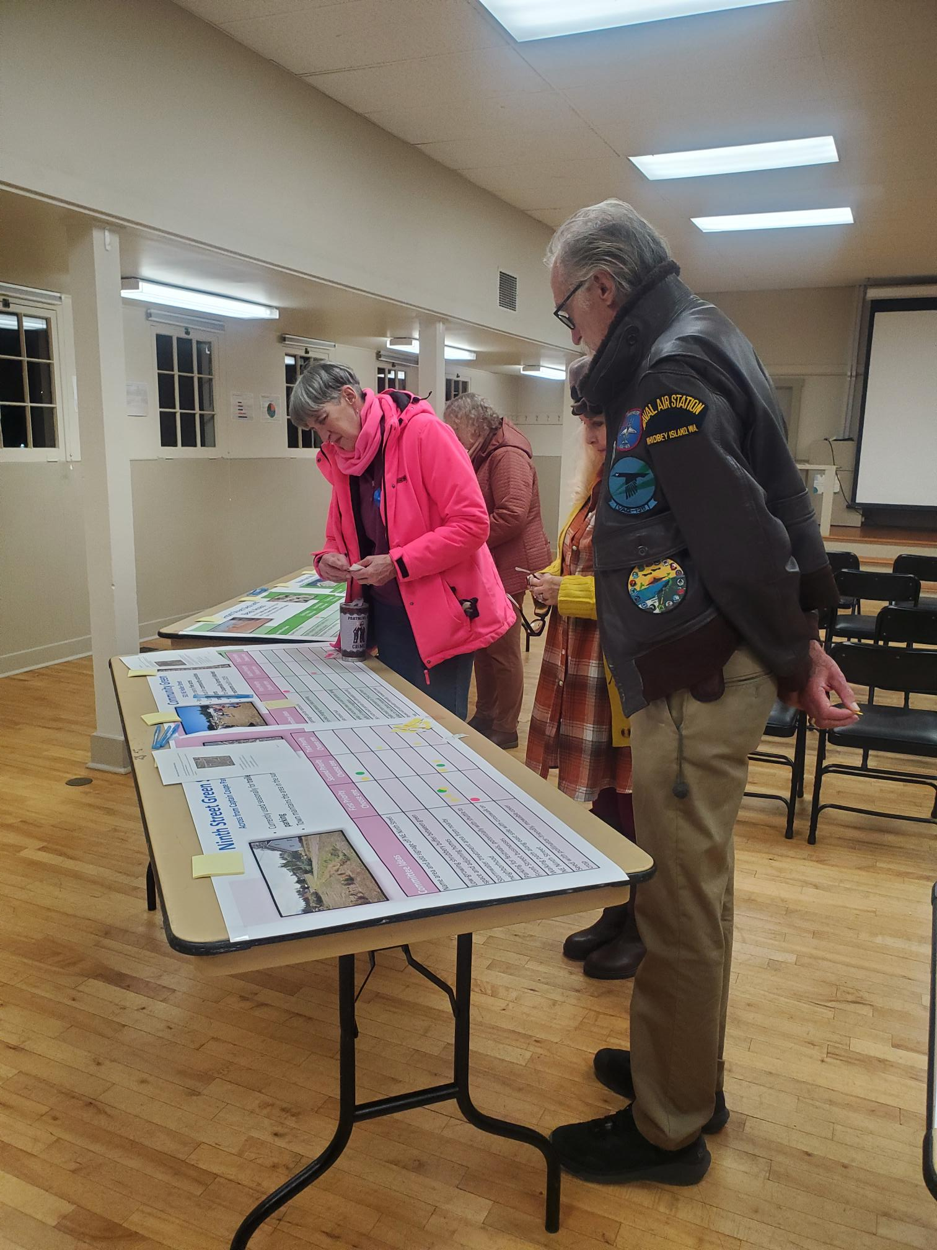
Community Open House
November 3, 2025 – Rec Hall
11 residents
Presentation
Active participation
Posters
Identified top priorities with weighted scoring system

Slide 31
Open House Feedback / Results
Park / Location | Top Priority
Town Park | Beach trail improvements
Gould Street Open Space | Improve access to area
Front Street Deck and Beach Access | Expand deck area
Captain Coupe Park | Repair/replace non-motorized boat launch
Summit Loop Park | Doggie bag station, garbage receptacle
Ninth Street Open Space | Parking for festivals / shuttle
Lions Park | New shade trees and landscaping / greenery
Community Garden | Soccer / Sports field with pickle ball option
Grace Street Parklet | Remove sidewalk curbs
Cooks Corner | Install Penn Cove history marker

Slide 32
Priorities Identified from all sources
Three Major Categories – Stood out as priorities:
-Trails and connectivity – Desire for linked, walkable routes
-Recreation facilities. Strong interest in pickleball and play areas
-Park amenities and comfort with benches, shade, picnic spaces as most valued

Slide 33
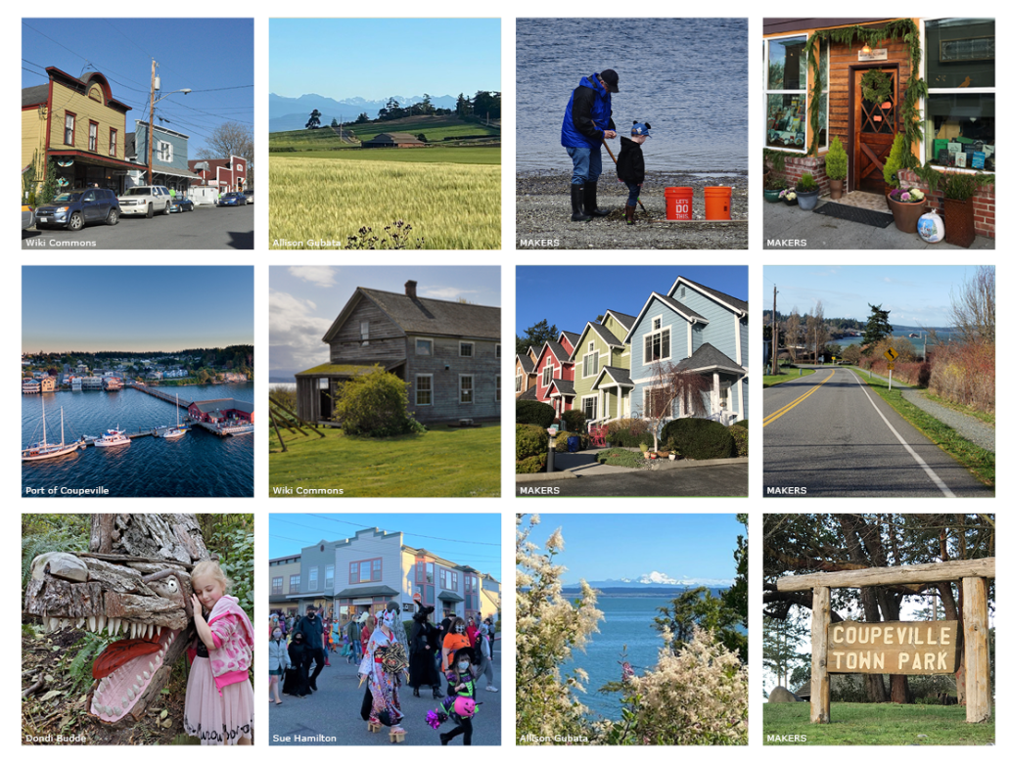
THANK YOU
Questions?

